Slide 1
Group Assignment RSM8502 – Data-Based Decision Making

Slide 2
The Story of DT Bank
DT Bank is one of the leading banks in Canada
Recent campaign to increase its revenue from selling fixed-term deposits
The campaign is based on direct contact via outbound sales calls
For every call, the bank has collected all relevant client data associated with the call

Slide 3
Jonah the Consultant
You are a data science expert hired by DT Bank to analyze the success of the campaign and to develop a recommender system that uses a suitable prediction model
The description of the dataset that you will use for your analysis appears in Appendix A

Slide 4
The Data (Appendix A)

Slide 5
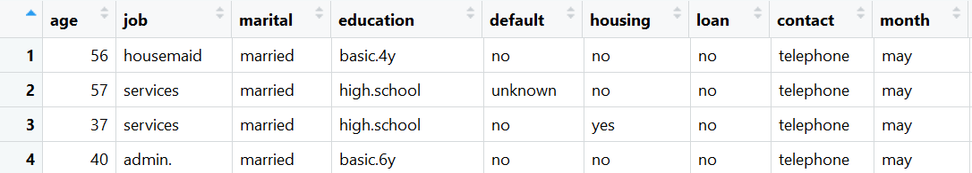
Data Overview
The dataset is stored in the file bank-additional-full.csv - ordered by date
It comprises outbound call information
The number of instances is 41188 with each record having 20 input attributes (covariates, features, predictors) and a (binary) output variable (prediction target, outcome)

Slide 6
Attributes: Group 1
General input attributes:
age (numeric)
job - type of job (categorical: "admin.","blue-collar","entrepreneur","housemaid","management","retired","self-employed","services","student","technician","unemployed","unknown")
marital : marital status (categorical: "divorced","married","single","unknown"; note: "divorced" means divorced or widowed)
education (categorical: "basic.4y","basic.6y","basic.9y","high.school","illiterate","professional.course","university.degree","unknown")
default: has credit in default? (categorical: "no","yes","unknown")
housing: has housing loan? (categorical: "no","yes","unknown")
loan: has personal loan? (categorical: "no","yes","unknown")

Slide 7
Attributes: Group 2
Input attributes related to the last contact of the current campaign:
contact: contact communication type (categorical: "cellular","telephone")
month: last contact month of year (categorical: "jan", "feb", "mar", ..., "nov", "dec")
day_of_week: last contact day of the week (categorical: "mon","tue","wed","thu","fri")
duration: last contact duration, in seconds (numeric). Important note: the duration variable is unknown before the sales call is finished

Slide 8
Attributes: Group 3
Historical attributes (campaign related):
campaign: number of contacts performed during this campaign and for this client (numeric, includes last contact)
pdays: number of days that passed by after the client was last contacted from a previous campaign (numeric; 999 means client was not previously contacted)
previous: number of contacts performed before this campaign and for this client (numeric)
poutcome: outcome of the previous marketing campaign (categorical: "failure","nonexistent","success")

Slide 9
Attributes: Group 4 (not available at first)
Socio-economic context variables:
emp.var.rate: employment variation rate - quarterly indicator (numeric)
cons.price.idx: consumer price index - monthly indicator (numeric)
cons.conf.idx: consumer confidence index - monthly indicator (numeric)
euribor3m: euribor 3 month rate - daily indicator (numeric)
nr.employed: number of employees - quarterly indicator (numeric)

Slide 10
Outcome y
Binary variable that states whether a sale has been made

Slide 11
Step 1: Exploratory Data Analysis

Slide 12
Question 1a
Load the data into your favorite data analysis software
Check for linear correlations between the input variables
Do you detect variables that are collinear (i.e., have a strong linear correlation between each other)?
Note: relevant to numeric variables only

Slide 13
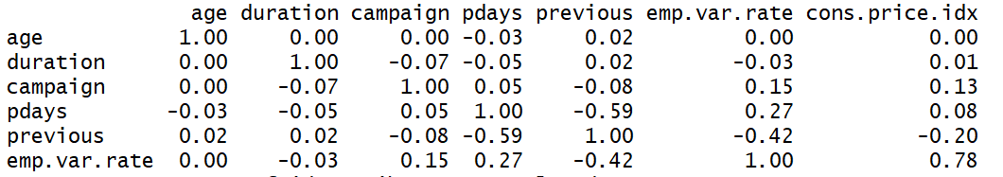
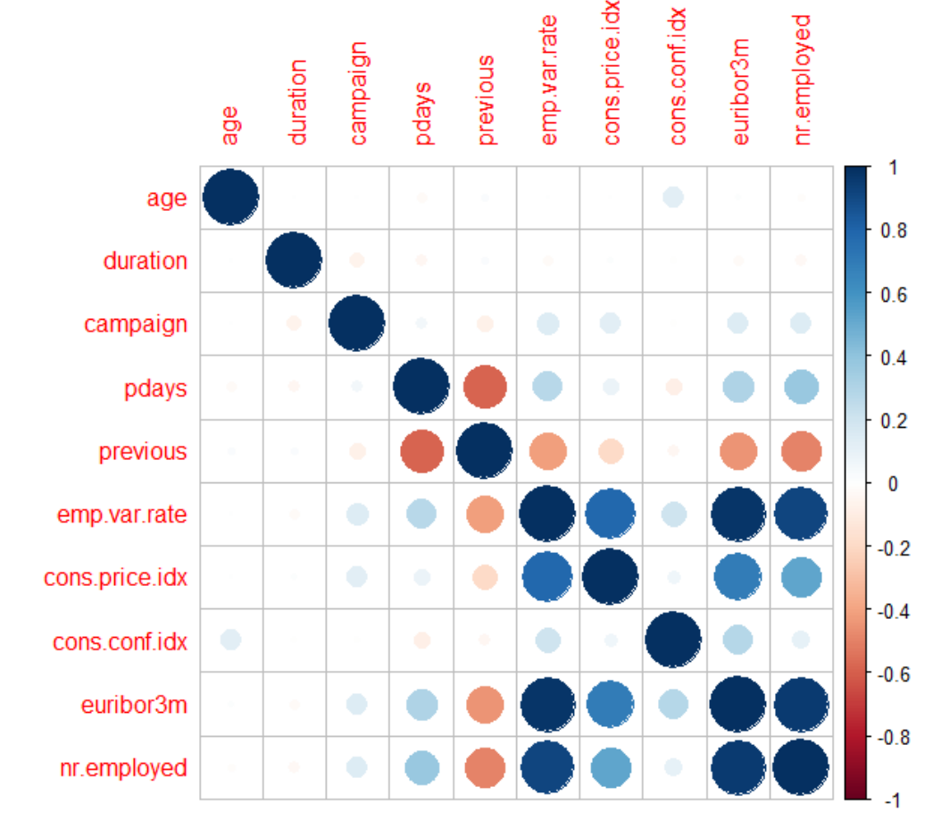
Question 1a: Example

Slide 14
Question 1b
Some of the variables exhibit missing values (`unknown' values). Propose at least two ways to handle missing values and apply one of your suggestions to deal with missing data.
You need to do a little bit of research on how to handle this: substitute the average value in for the missing value, drop the data point, etc…. You can also research this yourself by reading: http://www.stat.columbia.edu/~gelman/arm/missing.pdf
Numeric vs. categorical?

Slide 15
Question 1c
Use cross-tabulation analysis to test the dependency of different variables on the target variable (y)
Which of the variables seem to influence the target variable?
Use categorical only

Slide 16
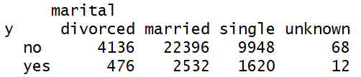
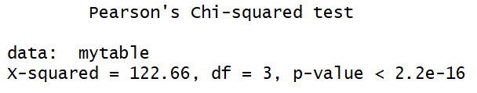
Question 1c: Example

Slide 17
Question 1d
Which of the three groups of input variables (Group1-Group3) do you find the most useful in explaining y based on your analysis so far?
Was the campaign successful?
Use the results of your cross-tab analysis + analyze the prior on the values of y

Slide 18
Step 2: Predictive Modeling

Slide 19
Predictive Modeling
Basis for the recommender system that the bank desires – prior to call, one wants to know the odds for success (and perhaps not call if the odds are low)
Sales representative’s time is money
Beyond prediction: can be useful to answer 1d more thoroughly – which of the variables explains successful calls?

Slide 20
Question 2a
Fit a suitable predictive model (from the models you learned in class) to predict the target variable y
Explain your choice (what model is most suitable? Why?)
Note that you are not limited to main effects (you may apply functions to input variables and consider interactions between the variables)

Slide 21
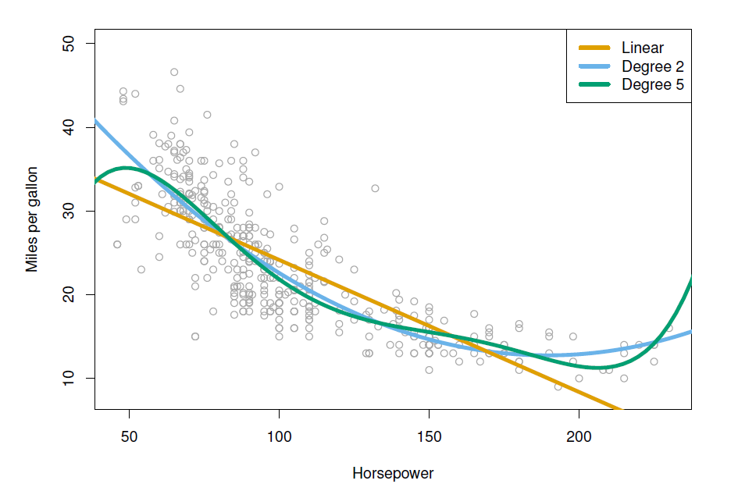
Question 2a: Applying functions
A variable could have a quadratic effect on y or the product of two X variables could be significant predictor.

Slide 22
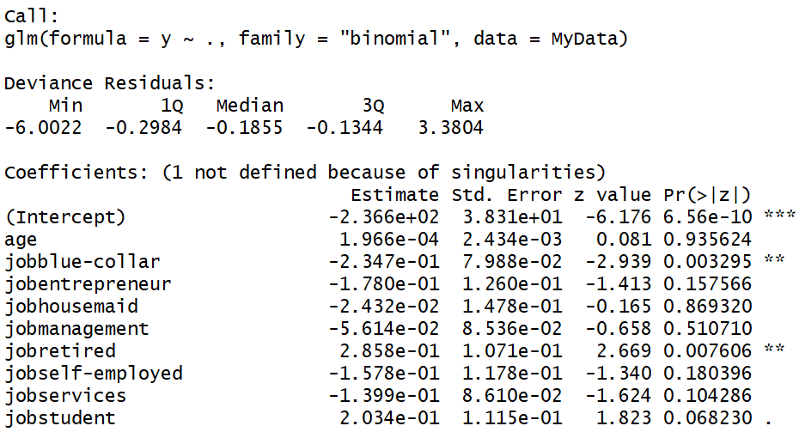
Question 2a: Example

Slide 23
Question 2b and 2c
Discuss whether using the variable duration as an input variable is a good idea.
Hint: consider the usefulness of the variable in predicting the success of a potential call.
Analyze the output of the model. Is the overall model significant?
Which of the variables are most influential?
Is this influence statistically significant?

Slide 24
Question 2d
How can you test the predictive power of your model?
You can look at R-Square and Max-rescaled R-Square and other Pseudo Rsquare like measurements relevant for the type of regression that you have applied
Please look at classification tables - in SAS Studio, under options select classification table and then find the cutoff that delivers the highest percentage of correct hits.

Slide 25



Question 2d: Classification Table
Threshold = 0.5
P(Y = TRUE| X) > 0.5 -> yes
Threshold = 0.7
P(Y = TRUE| X) > 0.7 -> yes
Threshold = 0.3
P(Y = TRUE| X) > 0.3 -> yes

Slide 26
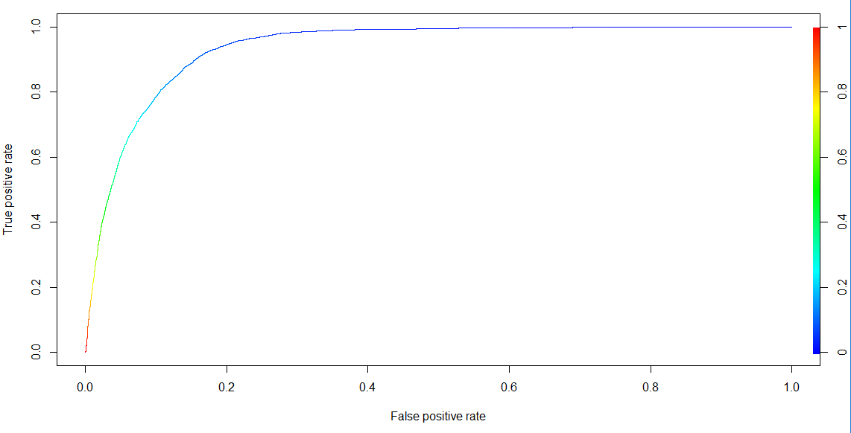
Receiver operating characteristic (ROC) Curve
Helps to select the optimal threshold (data specific)

Slide 27
Step 3: Sensitivity Analysis

Slide 28
Sheila the Assistant
Your assistant, Sheila Shortsight, is convinced that collecting socio-economic data about the bank's clients, which corresponds to the variables in Group 4 of the dataset
The price of the additional information is $5000. You know that DT Bank are willing to pay $1000$ dollars for every % of improvement beyond the model that you suggested in Part 2a.

Slide 29
Question 3a
Perform an analysis whether it is worth purchasing the extra data.
Prove your claims using two predictive models (one that uses only the first 3 groups of variables and one that uses all 4 groups)
Think back to the classification table (you obtain as output in SAS) and compare the highest percentage of correct hits that you can achieve with each model.

Slide 30
Question 3b
Perform a cross-tab analysis to Group 4 variables in order to explain differences in the target variable values as function of these input variables. Explain your findings.
Similar to Question 1c – but now for the new variables

Slide 31
Thank you For questions: Vivek.Nandur@Rotman.Utoronto.Ca

